Slide 1

APEX INSTITUTE OF TECHNOLOGY
DEPARTMENT OF COMPUTER SCIENCE & ENGINEERING
Artificial Intelligence (20CSD-385)
Faculty: Ankur Sharma(E13693)
Lecture – 2.1.3
forward chaining, Backward chaining
DISCOVER . LEARN . EMPOWER

Slide 2
Artificial Intelligence : Course Objectives
COURSE OBJECTIVES
(AI) is a research field that studies how to realize the intelligent human behaviors on a computer. The ultimate goal of AI is to make a computer that can learn, plan, and solve problems autonomously. Although AI has been studied for more than half a century, we still cannot make a computer that is as intelligent as a human in all aspects, The main research topics in AI include: problem solving, reasoning, planning, natural language understanding, computer vision, automatic programming, machine learning, and so on. Of course, these topics are closely related with each other. In this course, we will study the most fundamental knowledge for understanding AI. We will introduce some basic search algorithms for problem solving; knowledge representation and reasoning; pattern recognition; fuzzy logic; and neural networks

Slide 3
COURSE OUTCOMES
On completion of this course, the students shall be able to:-
CO3 | Design and Analyse search algorithms on well formulated problems.
CO4 | Evaluate the problem using Propositional and First order logic.

Slide 4
Unit-2 Syllabus
Unit-2 |  | Contact Hours:15 hours
Ch1. FOPL & Knowledge representation | First order logic. Inference in first order logic, propositional vs. first order inference, unification & lifts forward chaining, Backward chaining, Resolution,
Ch2. REASONING Programming: | Reasoning under uncertainty, review of probability, Bayes’ Logic probabilistic interferences and dempster Shafer theory.
Ch 3. Knowledge representation | Knowledge representation issues, predicate logic- logic programming, semantic nets- frames and inheritance, constraint propagation, representing knowledge using rules, rules-based deduction systems.

Slide 5
SUGGESTIVE READINGS
TEXT BOOKS
T1. Artificial Intelligence: A Modern Approach by Stuart Russell and Peter Norvig. Prentice-Hall, 2003 (2ndEdition). T2. Elaine Riche, Kevin Knight and Shivashankar B. Nair, “Artificial Intelligence”, Third Edition, TMH Educations Pvt. Ltd., 2008
REFERENCE BOOKS
R1 Nils J. Nilsson, “The Quest for Artificial Intelligence”, Second Edition, Cambridge University Press, 2009
R2 Artificial Intelligence and Expert Systems – Dan W. Patterson, Prentice Hall of India

Slide 6
FOPL & Knowledge representation
First order logic, Inference in first order logic, propositional vs. first order inference, unification & lifts forward chaining, Backward chaining, Resolution,

Slide 7
Forward chaining, Backward chaining
Forward and backward chaining
• Horn Form (restricted)
KB = conjunction of Horn clauses
– Horn clause =
• proposition symbol; or
• (conjunction of symbols) ⇒ symbol
– E.g., C ∧ (B ⇒ A) ∧ (C ∧ D ⇒ B)
• Modus Ponens (for Horn Form): complete for Horn KBs
α1, … ,αn, α1 ∧ … ∧ αn ⇒ β
-----------------------------------------------------------------
β
• Can be used with forward chaining or backward chaining.
• These algorithms are very natural and run in linear time

Slide 8
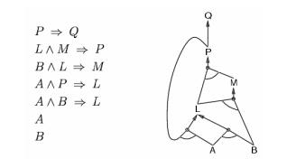
Forward chaining algorithm
Forward chaining
• Idea: fire any rule whose premises are satisfied in the KB,
– add its conclusion to the KB, until query is found

Slide 9
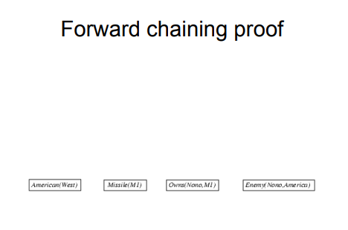
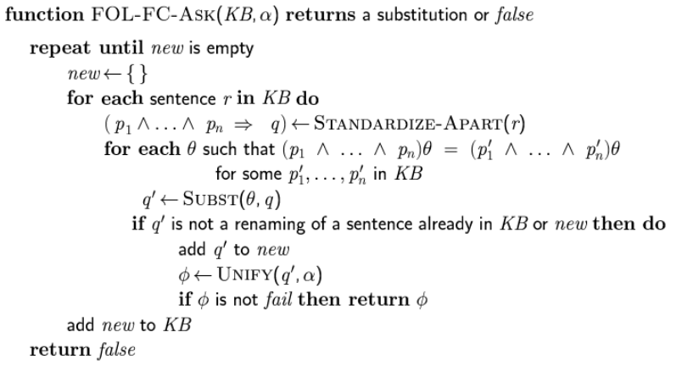
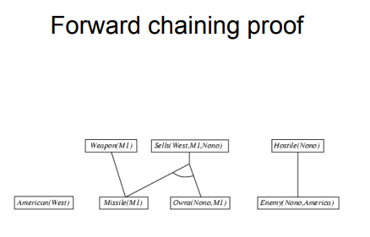
Forward chaining algorithm

Slide 10
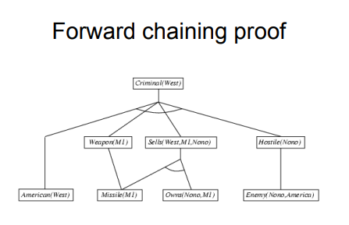
Properties of forward chaining
Properties of forward chaining
• Sound and complete for first-order definite clauses
• Datalog = first-order definite clauses + no functions
• FC terminates for Datalog in finite number of iterations
• May not terminate in general if α is not entailed
• This is unavoidable: entailment with definite clauses is
Semi decidable

Slide 11
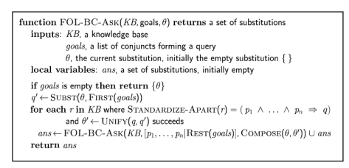

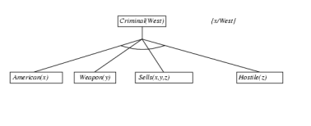
Backward chaining algorithm
Backward chaining example

Slide 12
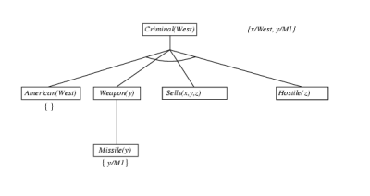
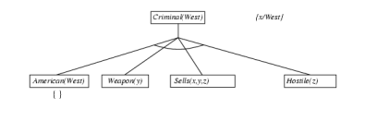
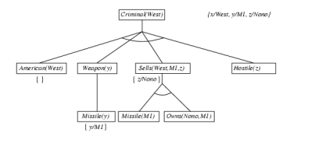
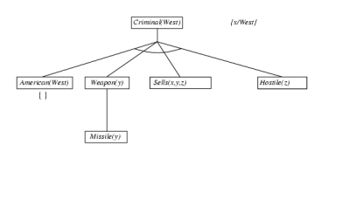
Backward chaining algorithm

Slide 13
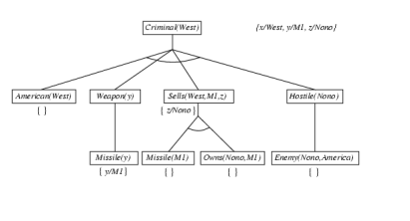
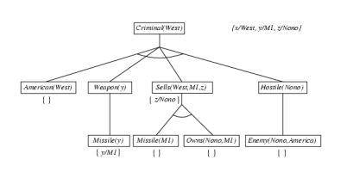
Properties of backward chaining
Properties of backward chaining
• Depth-first recursive proof search: space is
linear in size of proof
• Incomplete due to infinite loops
– ⇒ fix by checking current goal against every goal on stack
• Inefficient due to repeated subgoals (both
success and failure)
– ⇒ fix using caching of previous results (extra space)
• Widely used for logic programming

Slide 14
REFERENCES
Artificial Intelligence: A Modern Approach by Stuart Russell and Peter Norvig. Prentice-Hall, 2003 (2nd Edition).

Slide 15
THANK YOU
For queries
Email: Ankur.e13693@cumail.in

